Slide 1

Project Review Meeting on E-Commerce Product Catalouge
By
Simi Ayana - 2520030254
Srivalli - 2520090040
Team Number: 1
Under the guidance of
Ms.D. Pavithra
Assistant Professor
Department of Computer Science and Engineering
Koneru Lakshmaiah Education Foundation (Deemed to be University estd. u/s. 3 of the UGC Act, 1956) Off-Campus: Bachupally-Gandimaisamma Road, Bowrampet, Hyderabad, Telangana - 500 043. Phone No: 7815926816, www.klh.edu.in

Slide 2
Abstract
The E-Commerce Product Catalogue is a web application that allows users to browse, search, compare and filter products efficiently. Built using React.js, Node.js and Express.js, it includes product listing, search suggestions, sorting, wishlist and comparison features. The price comparison feature helps users identify the best deals across platforms and make smarter purchasing decisions.

Slide 3
Introduction
•Online shopping platforms contain thousands of products, making product discovery difficult. This project provides a centralized catalogue where users can easily explore products, apply filters and compare options. The system focuses on improving shopping convenience and user experience.

Slide 4
Problem Statement
•Users often spend significant time searching across multiple shopping platforms to compare products and prices. Lack of centralized comparison and filtering makes decision-making difficult. This project addresses these challenges by providing a unified product catalogue with advanced search and comparison features.

Slide 5
Project Flow Diagram
User Login / Access
↓
Browse Product Categories
↓
Search & Apply Filters
↓
View Product Details
↓
Compare Products & Prices
↓
Add to Wishlist
↓
Select Best Product

Slide 6
Objectives with Justification
1. To develop a centralized airport operations dashboard.
Justification: A centralized platform allows airport managers to monitor all critical operational information from a single interface, improving efficiency and decision-making.
2. To monitor flight operations and delays in real time.
Justification: Real-time tracking of flights and delays helps identify operational issues quickly and supports timely corrective actions.

Slide 7
Objectives with Justification
3. To analyze airport slot utilization and resource allocation.
Justification: Efficient slot management reduces congestion, improves airport capacity utilization, and supports smooth flight operations.
4. To detect and manage gate conflicts effectively.
Justification: Early detection of gate conflicts minimizes operational disruptions and helps maintain scheduled flight movements.
5. To provide operational alerts, reports, and decision-support information.
Justification: Notifications, alerts, and exportable reports enable airport managers to respond quickly to issues and make data-driven decisions.

Slide 8
Modules [Frontend web pages]
Login Page - User authentication and secure access
Dashboard Page - Displays KPI summaries and airport overview
Slot Utilization Page - Monitors airport slot allocation
Delay Analysis Page - Shows flight delay heatmaps
Flight Operations Page - Displays flight schedules and status

Slide 9
Modules [Frontend web pages]
Weather Monitoring Page - Shows weather information
Gate Conflict Page - Detects gate assignment conflicts
Staff Management Page - Manages staff schedules and availability
Notifications Page - Displays alerts and operational updates
Admin Panel - System settings and configuration
Export Reports Page - Generates operational reports

Slide 10
Expected Outcomes of the Proposed Work
• Faster product discovery.
• Improved shopping experience.
• Better price transparency.
• Easier comparison of features and specifications.
• Increased user satisfaction and informed purchasing decisions.

Slide 11
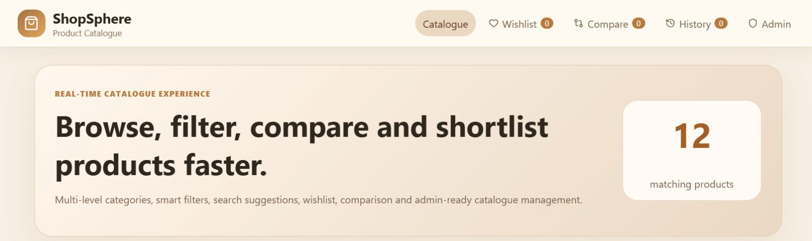
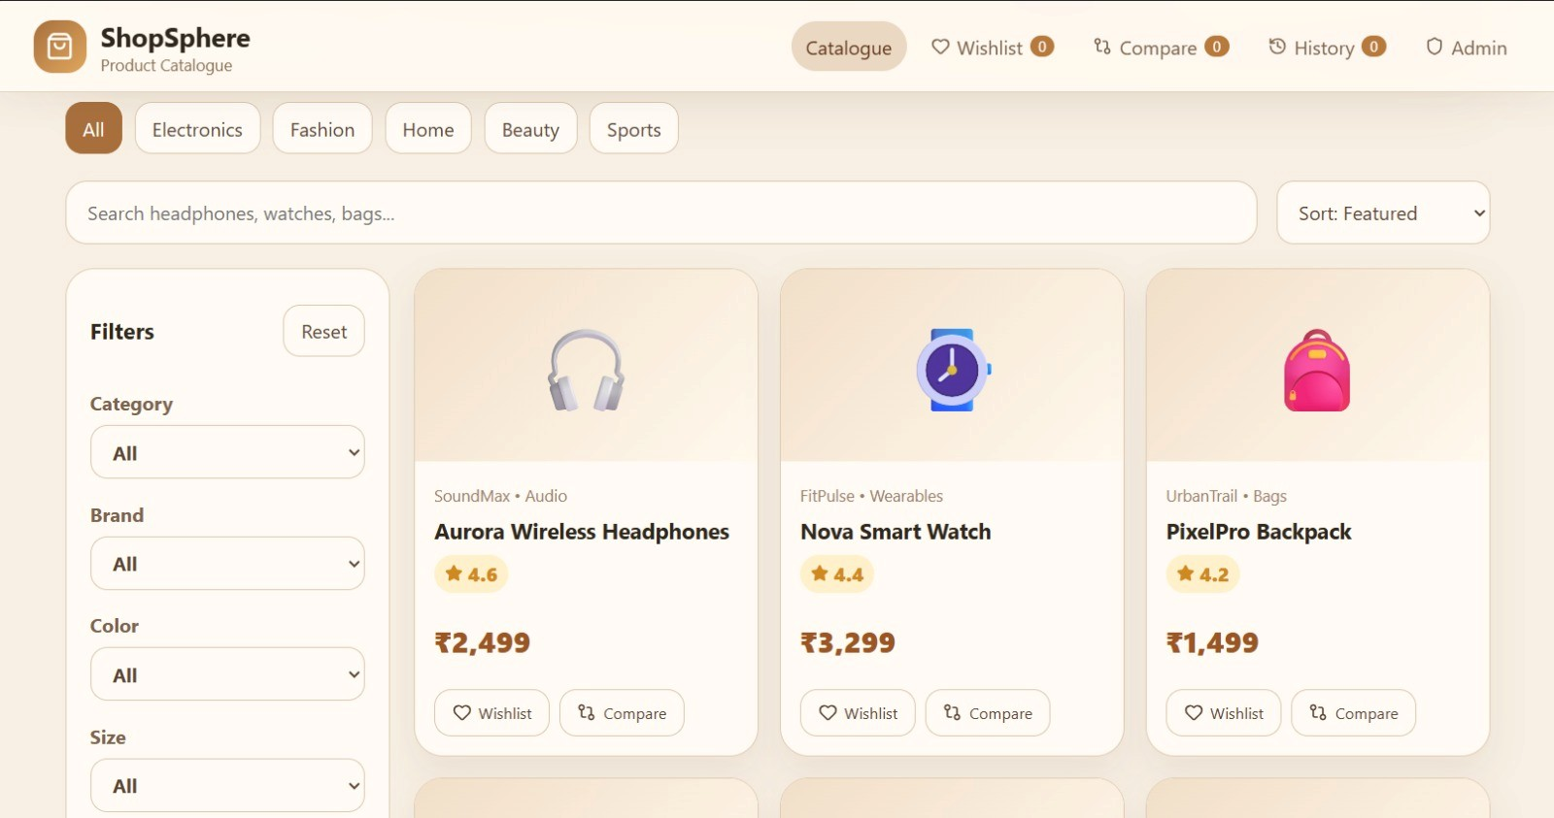
OUTPUT

Slide 12
Conclusion and Future Scope
The project simplifies online product exploration through efficient search, filtering and comparison features. Future enhancements may include AI-based recommendations, real-time price tracking, personalized suggestions and mobile application support.

Slide 13
References
1. React.js Documentation
2. Node.js Documentation
3. Express.js Documentation
4. MDN Web Docs
5. E-Commerce Website Design Resources

Slide 14
Thank you

